Slide 1
Unit-5
Managing Kernel Modules

Slide 2
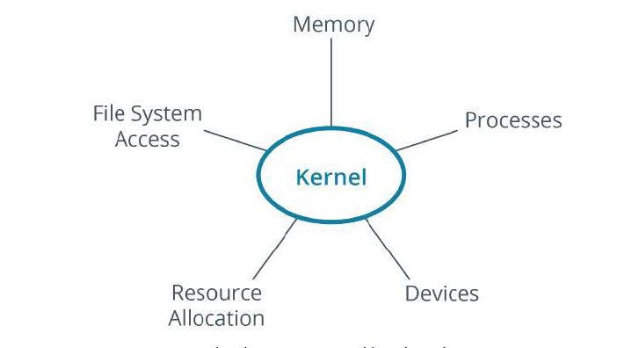
KErnel
kernel is the core of an operating system. All other components rely on it. The kernel manages file system access, memory, processes, devices, and resource allocation on a system.

Slide 3
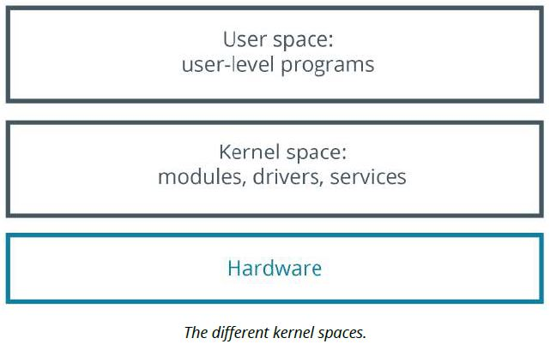
KERNEL SPACE AND USER SPACE
The kernel space is simply where the kernel executes the services that it provides.
The user space is the area of memory that includes everything outside of kernel space.

Slide 4
TYPES OF KERNELS
In a monolithic kernel, all system modules, such as device drivers or file systems, run in kernel space. As a result, a monolithic kernel can interact quickly with devices.
a microkernel architecture, the kernel itself runs the minimum amount of resources necessary to actually implement a fully functional operating system.
Compared to monolithic kernels, microkernels have smaller kernel spaces and instead have larger user spaces. This means microkernels are smaller in overall size and consume less memory
DEVICE DRIVERS

Slide 5
Features | Microkernel | Monolithic Kernel
Definition | It is a kernel type that implements an operating system by providing low-level address space management, IPC, and thread management. | It is a type of kernel in which the complete operating system runs at the kernel speed.
Size | It is smaller in size. | It is bigger than the microkernel.
Speed | Its process execution is slower. | Its process execution is faster.
Basic | It implements kernel and user services in different address spaces. | It implements both user and kernel services in the same address space.
Security | It is more secure than the monolithic kernel. | It is less secure than the microkernel.
Stability | A single process failure does not affect other processes. | In a monolithic kernel, if a service fails, the entire system fails.
Extendible | It is easy to extend. | It is hard to extend.
Code | More code is necessary to write a microkernel. | Less code is necessary to write a monolithic kernel.
Inter-Process | Communication Microkernels use the messaging queues to achieve IPC. | The monolithic kernels use signals and sockets to achieve IPC.
Maintainability It is easily maintainable. | Maintenance takes extra time and resources.
Debug | It is easy to debug. | It is hard to debug.

Slide 6
THE LINUX KERNEL
The Linux kernel is a free and open source monolithic kernel that manages all other resources on the operating system.

Slide 7
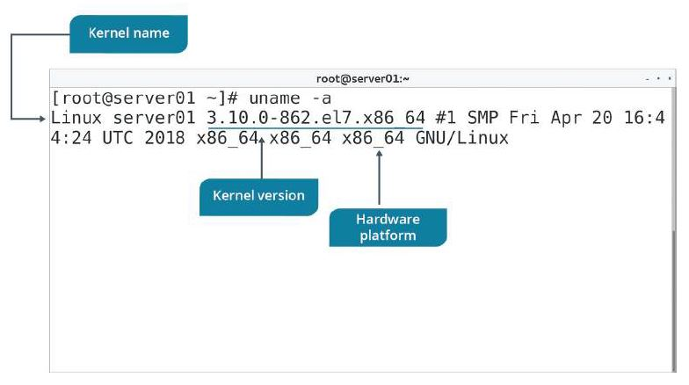
THE uname COMMAND
uname prints the name of the kernel—Linux.
You can view the kernel version number of your current system by using the uname -r command.
You can also enter uname -i to view the hardware platform.
To print all information, enter the uname -a command.

Slide 8
Kernel layers
1) System Call Interface (SCI) :- Handles system calls sent from user applications to the kernel. This enables user space applications to request services from the kernel space, like processing time and memory allocation.
2) Process management :- Handles different processes by allocating separate execution space on the processor and ensuring that the running of one process does not interfere with other processes.
3) Memory management :- Manages the computer's memory, which is one of the complex tasks performed by the kernel. Like processor sharing, the system's memory also needs to be shared among different user space resources.

Slide 9
4) File system management :- Manages the filesystem, which involves storing, organizing, and tracking files and data on a computer.
5) Device management :- Manages devices by controlling device access and interfacing between user applications and hardware devices of the computer.

Slide 10
Which function is associated with the SCI layer of the kernel?
Passing requests to device drivers.
Sending service requests to the kernel.
Allocating processor time for functions.
Processing scheduling functions.
Organizing files on the file system.

Slide 11
Which function is associated with the SCI layer of the kernel?
Passing requests to device drivers.
Sending service requests to the kernel.
Allocating processor time for functions.
Processing scheduling functions.
Organizing files on the file system.

Slide 12
KERNEL MODULES
kernel module is a system-level object that extends the functionality of the kernel. It can be dynamically loaded into the kernel or unloaded from the kernel when required.

Slide 13
THE /usr/lib/ DIRECTORY
The /usr/lib/ directory contains shared libraries and binaries for general programs and software packages.
More specifically, the /usr/lib/ modules/ directory contains the modules of different kernel versions that are installed.
For example, a Bluetooth® driver may be stored in:
/usr/lib/modules/<kernel version>/kernel/drivers/bluetooth/

Slide 14
KERNEL MODULE SUBDIRECTORIES
Inside /usr/lib/modules/<kernel version>/kernel/ are several subdirectories
arch --→contain modules for Architecture-specific support.
crypto →Encryption and other cryptographic functions.
drivers →Various types of hardware.
fs →Various types of file systems.
net →Networking components such as firewalls and protocols.

Slide 15
THE modprobe COMMAND
The modprobe command is used to add or remove modules from a kernel. This command is capable of loading all the dependent modules before inserting the specified module. It is therefore preferred over using the insmod and rmmod commands.
To add modules using modprobe, use the -a option and specify the modules you
want to add. To unload a module, use the -r option and specify the modules you want to remove.
SYNTAX
The syntax of the modprobe command is modprobe [options] [modulenames]

Slide 16
Kernel module configuration
The /etc/modprobe.conf file is a configuration file that contains settings that apply persistently to all the modules loaded on the system. It is used to configure modules and their dependencies and also specify module aliases. An alias is just an alternative name to use for a module.

Slide 17
THE sysctl COMMAND
The sysctl command is used to view or set kernel parameters at runtime.
Option Used To
-a →Display all parameters and their current values.
-w {parameter}={value} →Set a parameter value.
-p[file name] →Load sysctl settings from the specified file,
or /etc/sysctl.conf if no file name is provided.
-e →Ignore errors about unknown keys.
-r {pattern} →Apply a command to parameters matching a
given pattern, using extended regular expressions.
SYNTAX
The syntax of the sysctl command is sysctl [options]
THE /etc/sysctl.conf FILE
The /etc/sysctl.conf file enables configuration changes to a running Linux kernel. These changes might include improvements to networking, security configurations, or logging of information.

Slide 18
Monitoring kernel Modules
THE /proc/ DIRECTORY
The /proc/ directory is a virtual file system (VFS) that provides significant information about the kernel's running process.
/proc/cmdline →Options passed to the kernel by the boot loader at boot time, such as mounting the kernel as read-only.
/proc/cpuinfo → CPU information, such as its architecture, name, clock peed, cache size, and more.
/proc/devices → A list of character and block device drivers loaded into the currently running kernel.
/proc/filesystems → A list of file systems types that are supported by the kernel, as well as if any are currently mounted.
/proc/meminfo → Information about RAM usage, including total memory, free memory, and much more.
/proc/modules →Information about modules currently installed on the system. An alternative to the lsmod command.
/proc/stat → Various statistics about the system since it was last rebooted.

Slide 19
THE /proc/version FILE
The /proc/version file specifies several points of information about the Linux kernel:
• The version of the Linux kernel currently running.
• The version of the GNU Compiler Collection (GCC) used to compile the kernel.
• The user name of the kernel compiler.
• The time the kernel was compiled.

Slide 20
THE dmesg COMMAND
The dmesg ("display message" or "driver message") command is used to print any messages that have been sent to the kernel's message buffer during and after system boot.
SYNTAX
The syntax of the dmesg command is dmesg [options]

Slide 21
Configuring Boot Components
The Boot ProcessThe boot process can be initiated in one of a couple ways. First, if power is turned off, turning on the power will begin the boot process. If the computer is already running a local user, including root or an unprivileged user, the user can programmatically initiate the boot sequence by using the GUI or command line to initiate a reboot. A reboot will first do a shutdown and then restart the computer.
Booting a Linux installation involves multiple stages and software components, including firmware initialization, execution of a boot loader, loading and startup of a Linux kernel image, and execution of various startup scripts and daemons. For each of these stages and components there are different variations and approaches

Slide 22
The Boot Loader
A boot loader is a small, simple program responsible for loading the Linux kernel with optional kernel parameters and the Linux initial RAM disk, known as initrd. Linux kernel is the core of the Linux operating system, and it starts the init (short for initialization) process, or an init replacement such as systemd, immediately after being loaded. The Linux initial RAM disk provides a temporary storage space for loading critical files into memory before the real root file system can be mounted.

Slide 23
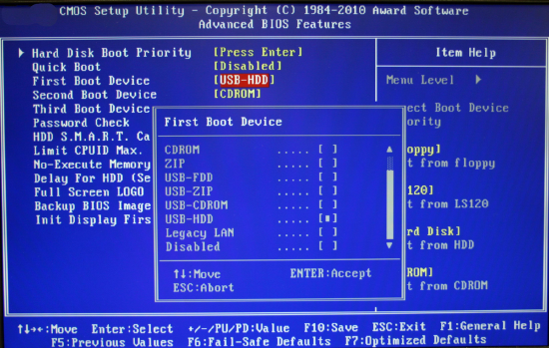
The BIOS
BIOS is an acronym for Basic Input/Output System. It is firmware used to perform hardware initialization during the booting process (power-on startup), and to provide runtime services for operating systems and programs.
Notes:
The BIOS firmware comes pre-installed on a personal computer's system board, and it is the first software to run when powered on.

Slide 24
UEFI
The Unified Extensible Firmware Interface (UEFI) is a specification that defines a software interface between an operating system and platform firmware. UEFI replaces the legacy Basic Input/Output System (BIOS) firmware interface originally present in all IBM PC-compatible personal computers,[1][2] with most UEFI firmware implementations providing support for legacy BIOS services. UEFI can support remote diagnostics and repair of computers, even with no operating system installed.
Just like the BIOS, UEFI is an environment in which to execute a boot loader, and both eventually execute the operating system.

Slide 25
Server Security
As long as we are discussing BIOS/UEFI, its a good time to mention the idea of password protecting the boot sequence. Many Linux system administrators make use of the capability that both BIOS and UEFI have to put a password on the boot sequence. This prevents someone from gaining access to a corporate server, simply rebooting it and taking control. Sometimes it takes a bit of searching around in the BIOS/UEFI menu to find the place to enter a password. As there is greater focus being placed on security - both hardware and software - this is something to consider.

Slide 26
Boot Source Options
In addition to the normal idea of booting from the system's hard drive, there are other options that are used in various situations.
Boot source | Description
ISO | Most Linux distributions can be downloaded as an ISO image. These are images of an actual Linux system. It is possible to boot directly from an ISO file that resides on a hard disk, or on a USB device. It is also possible to view the file system found on an ISO image using an archiving utility.
Network File System (NFS) | Network File Systems (NFS) can be used as a source of the boot files. This simply means that the boot files are not physically loaded on the machine being booted. The files are accessed across the network. This method must be set up both on the local system and the remote NFS server where the files are located. This boot method makes use of NFS, tftp or other network protocols to retrieve the necessary files.
HTTP/FTP | HTTP Boot combines DHCP, DNS, and HTTP to make it possible to boot and deploy systems over the network. HTTP Boot can be used as a high-performance replacement for PXE. HTTP Boot allows you to boot a server from a URI over HTTP, quickly transferring large files such as the Linux kernel and root file system from servers outside of your local network.
PXE | The Preboot eXecution Environment (PXE, also known as Pre-Execution Environment; sometimes pronounced "pixie") is an environment to boot computers using a network interface independently of data storage devices (like hard disks) or installed operating systems.

Slide 27
The Boot Process
The Linux startup process is the multi-stage initialization process performed during booting a Linux installation. It is in many ways similar to the BSD(Berkeley Software Distribution) and other Unix-style boot processes, from which it derives.
https://eng.libretexts.org/Bookshelves/Computer_Science/Operating_Systems/Linux_-_The_Penguin_Marches_On_(McClanahan)/07%3A_Linux_Boot_Process/1.01%3A_Configuring_Boot_Components
Notes:
Booting a Linux installation involves multiple stages and software components, including firmware initialization, execution of a boot loader, loading and startup of a Linux kernel image, and execution of various startup scripts

Slide 28
Kernel Panic
A kernel panic is a safety measure taken by an operating system's kernel upon detecting an internal fatal error, in which it either is unable to safely recover or cannot have the system continue to run without having a much higher risk of major data loss. The term is largely specific to Unix and Unix-like systems.
Notes:
A panic may occur as a result of a hardware failure or a software bug in the operating system. In many cases, the operating system is capable of continued operation after an error has occurred. However, the system is in an unstable state and rather than risking security breaches and data corruption, the operating system stops to prevent further damage and facilitate diagnosis of the error and, in usual cases, restart.

Slide 29
GNU GRUB
GNU GRUB (short for GNU GRand Unified Bootloader, commonly referred to as GRUB) is a boot loader package from the GNU Project. GRUB is the reference implementation of the Free Software Foundation's Multiboot Specification, which provides a user the choice to boot one of multiple operating systems installed on a computer or select a specific kernel configuration available on a particular operating system's partitions.
Notes:
Need of grub
The GRUB (Grand Unified Bootloader) is a tool for booting and loading operating system kernels and the default bootloader for systems based on the Linux kernel. Although it runs first when a machine is turned on, regular users rarely see GRUB in action.

Slide 30
The grub2-install Command
grub2-install installs GRUB onto a device. This includes copying GRUB images into the target directory (generally /boot/grub), and on some platforms may also include installing GRUB onto a boot sector. If grub2 is being installed on a UEFI system make sure to use the --efi-directory option so the files get placed in the proper directory.
Syntax:
grub-install [OPTIONS]... INSTALL_DEVICE
Notice the command is grub-install even though it installs grub2

Slide 31
Command Options
Option | Option Meaning
--modules=MODULES | Pre-load modules specified by MODULES.
--install-modules=MODULES | Install only MODULES and their dependencies. The default is to install all available modules.
--themes=THEMES | Install THEMES. The default is to install the starfield theme, if available.
--fonts=FONTS | Install FONTS. The default is to install the unicode font.
--locales=LOCALES | Install only locales listed in LOCALES. The default is to install all available locales.
--compress=no,xz,gz,lzo | Compress GRUB files using the specified compression algorithm.
--directory=DIR | Use images and modules in DIR.
--grub-mkimage=FILE | Use FILE as grub-mkimage. The default is /usr/bin/grub-mkimage.
--boot-directory=DIR | Use DIR as the boot directory. The default is /boot. GRUB will put its files in a subdirectory of this directory named grub.
--target=TARGET | Install GRUB for TARGET platform. The default is the platform grub-install is running on.
--grub-setup=FILE | Use FILE as grub-setup. The default is /usr/bin/grub-setup.
--grub-mkrelpath=FILE | Use FILE as grub-mkrelpath. The default is /usr/bin/grub-mkrelpath.
--grub-probe=FILE | Use FILE as grub-probe. The default is /usr/bin/grub-mkrelpath.
--allow-floppy | Make the device also bootable as a floppy. This option is the default for /dev/fdX devices. Some BIOSes will not boot images created with this option.
--recheck | Delete any existing device map and create a new one if necessary.
--force | Install even if problems are detected.
--force-file-id | Use identifier file even if UUID is available.
--disk-module=MODULE | Use MODULE for disk access. This allows you to manually specify either biosdisk or native disk access. This option is only available on the BIOS target platform.
--removable | Treat the target device as if it is removable. This option is only available on the EFI target platform.
--bootloader-id=ID | Use ID as the bootloader ID. This option is only available on the EFI target platform.
--efi-directory=DIR | Use DIR as the EFI System Partition root. This option is only available on the EFI target platform.
INSTALL_DEVICE | Install GRUB to the block device INSTALL_DEVICE.

Slide 32
Presently, GRUB2 has replaced its past version (GRUB), which is now known as GRUB Legacy. Importantly, we can check for the GRUB version in our system using the following command:
$ sudo grub-install -V grub-install (GRUB) 2.07-2ubuntu7

Slide 33
Now, let’s see what GRUB2 does in the boot process:
takes over from BIOS or UEFI at boot time
loads itself
inserts the Linux kernel into memory
turns over execution to the kernel
Notably, the GRUB configuration file is located at /boot/grub by default:
$ ls -l /boot/grub/
total 2380
-rw-r--r-- 2 root root 9006 SEP 30 22:14 /boot/grub/grub.cfg ...

Slide 34
You are logged in to CLI as your student account.SCENARIOSome of your fellow administrators are claiming that their Linux servers aren't booting properly. You are assigned to the task of troubleshooting these issues. You find that someone has modified the settings in the boot loader because there is no password protection. After correcting the boot configuration, you decide to protect GRUB 2 with a password so that only authorized users can modify it.

